Slide 1
IN723 VPN
GRE
IPSec
GRE over IPSEC

Slide 2
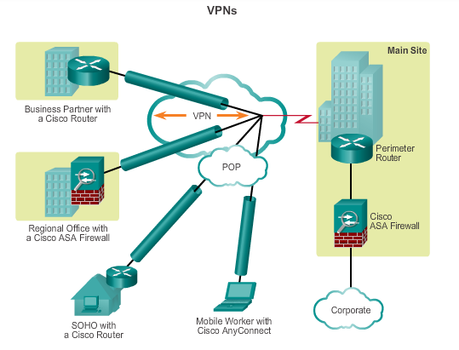
Fundamentals of VPNs Introducing VPNs
VPNs are used to create an end-to-end private network connection over third-party networks, such as the Internet or extranets.
To implement VPNs, a VPN gateway is necessary: Could be a router, a firewall, or a Cisco Adaptive Security Appliance (ASA).
Notes:
7.1.1.1 Introducing VPNs

Slide 3
Fundamentals of VPNs Benefits of VPNs
Cost savings
Enable organizations to use cost-effective, third-party Internet transport to connect remote offices and remote users to the main site.
Scalability
Enable organizations to use the Internet infrastructure within ISPs and devices, which makes it easy to add new users.
Notes:
7.1.1.2 Benefits of VPNs

Slide 4
Fundamentals of VPNs Benefits of VPNs (cont.)
Compatibility with broadband technology
Allow mobile workers and telecommuters to take advantage of high-speed, broadband connectivity, such as DSL and cable, to gain access to the networks of their organization, providing workers flexibility and efficiency.
Provide a cost-effective solution for connecting remote offices.
Security
Can include security mechanisms that provide the highest level of security by using advanced encryption and authentication protocols that protect data from unauthorized access.
Notes:
7.1.1.2 Benefits of VPNs

Slide 5
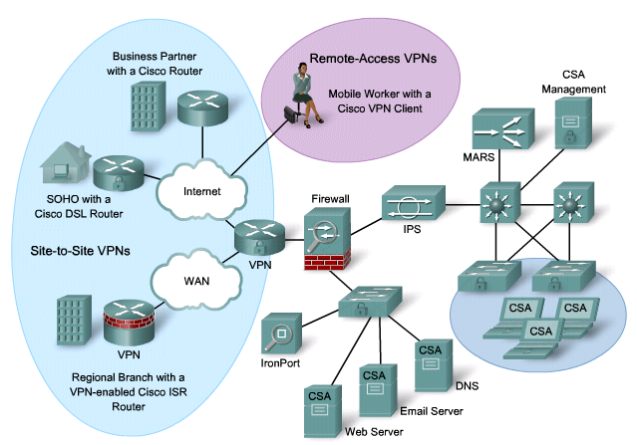
VPN Solutions
There are basically two VPN solutions:
Site-to-site VPNs
VPN endpoints are devices such as routers.
The VPN is completely hidden from the users.
Remote-access VPNs
A mobile user initiates a VPN connection request using either VPN client software or an Internet browser and SSL connection.

Slide 6
Types of VPNs Site-to-Site VPNs
Connect entire networks to each other, in the past, a leased line or Frame Relay connection was required to connect sites, but because most corporations now have Internet access, these connections can be replaced with site-to-site VPNs.
Internal hosts have no knowledge that a VPN exists.
Created when devices on both sides of the VPN connection are aware of the VPN configuration in advance.
Notes:
7.1.2.1 Site-to-Site VPNs

Slide 7
Types of VPNs Remote Access VPNs
Support the needs of telecommuters, mobile users, and extranet, consumer-to-business traffic.
Support a client/server architecture, where the VPN client (remote host) gains secure access to the enterprise network via a VPN server device at the network edge.
Used to connect individual hosts that must access their company network securely over the Internet.
VPN client software may need to be installed on the mobile user’s end device (Cisco AnyConnect Secure Mobility Client).
When the host tries to send any traffic, the VPN Client software encapsulates and encrypts this traffic and sends over the Internet to the VPN gateway at the edge of the target network.
Notes:
7.1.2.2 Remote Access VPNs

Slide 8
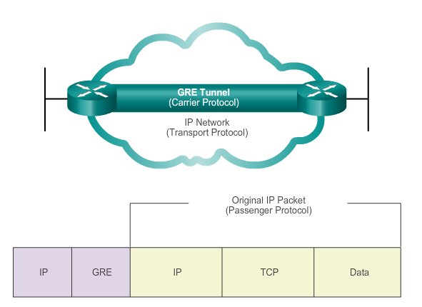
Fundamentals of Generic Routing Encapsulation Introduction to GRE
Basic, non-secure, site-to-site VPN tunneling protocol developed by Cisco
Encapsulates a wide variety of protocol packet types inside IP tunnels
Creates a virtual point-to-point link to routers at remote points, over an IP internetwork
Notes:
7.2.1.1 Introduction to GRE
GRE is defined as an IETF standard.
IP protocol 47 is used to identify GRE packets.
GRE encapsulation uses a protocol type field in the GRE header to support the encapsulation of any OSI Layer 3 protocol.
GRE itself is stateless; it does not include any flow-control mechanisms, by default.
GRE does not include any strong security mechanisms to protect its payload.
The GRE header, together with the tunneling IP header, creates at least 24 bytes of additional overhead for tunneled packets.

Slide 9
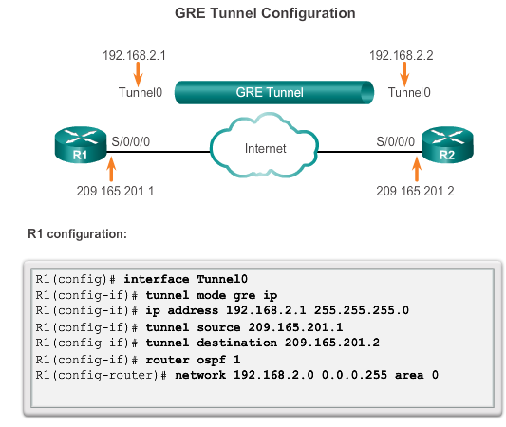
Configuring GRE Tunnels GRE Tunnel Configuration
Notes:
7.2.2.1 GRE Tunnel Configuration

Slide 10
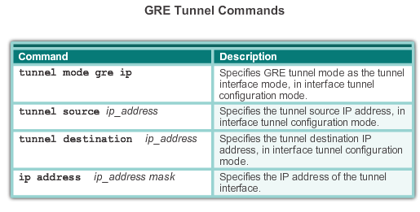
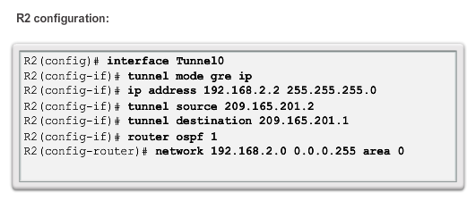
Configuring GRE Tunnels GRE Tunnel Configuration
Notes:
7.2.2.1 GRE Tunnel Configuration
Tunnel src & dst must be reachable (connectivity exist) before tunnel can be established

Slide 11
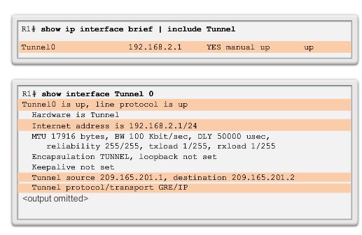
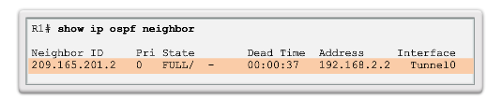
Configuring GRE Tunnels GRE Tunnel Verification
Verify Tunnel
Interface is Up
Verify OSPF Adjacency
Notes:
7.2.2.2 GRE Tunnel Verification

Slide 12
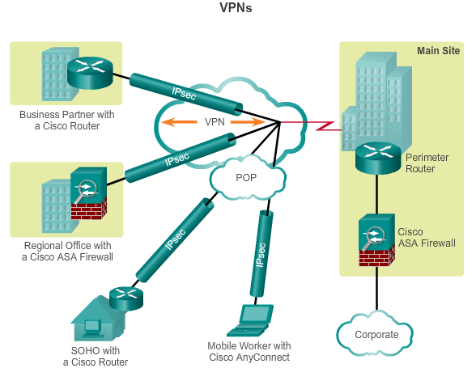
Internet Protocol Security IPsec VPNs
Information from a private network is securely transported over a public network.
Forms a virtual network instead of using a dedicated Layer 2 connection.
To remain private, the traffic is encrypted to keep the data confidential.
Notes:
7.3.1.1 IPsec

Slide 13
IPsec Technologies
IPsec VPNs provide two significant benefits:
Encryption
Encapsulation
IPsec encryption provides three major services:
Confidentiality
Integrity
Authentication
Notes:
IPsec provides two significant benefits:
Encryption—Using a cryptographic algorithm, IPsec encrypts the data exchanged by the corporate offices that are using the public Internet.
Encapsulation—Using tunneling technology, it encapsulate the data as it leaves a corporate site, thus protecting its original IP address and providing the illusion to the recipient that the sender is located within the organization.
IPsec encryption provides three major services:
Confidentiality—Confidentiality provides encryption during the exchange of the data. Only the recipient in possession of the valid key can decrypt the packets. Confidentiality is provided by cryptographic algorithms, such as Data Encryption Standard (DES), Triple DES (3DES), and Advanced Encryption Standard (AES).
Integrity—Integrity provides a check to confirm that the data was not altered during the transmission. Integrity checks are provides by hashing algorithms such as message digest algorithm 5 (MD5) and Secure Hash (SHA).

Slide 14
Internet Protocol Security IPsec Security Services
Confidentiality (encryption) – encrypt the data before transmitting across the network
Data integrity – verify that data has not been changed while in transit, if tampering is detected, the packet is dropped
Authentication – verify the identity of the source of the data that is sent, ensures that the connection is made with the desired communication partner, IPsec uses Internet Key Exchange (IKE) to authenticate users and devices that can carry out communication independently.
Anti-Replay Protection – detect and reject replayed packets and helps prevent spoofing
CIA: confidentiality, integrity, and authentication
Notes:
7.3.1.2 IPsec Security Services

Slide 15
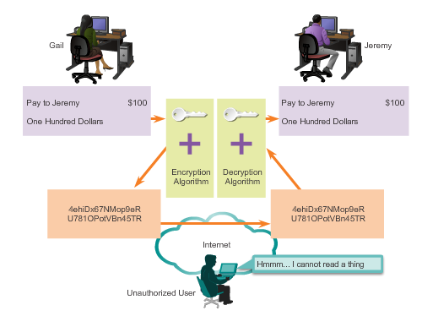
IPsec Framework Confidentiality with Encryption
For encryption to work, both the sender and the receiver must know the rules used to transform the original message into its coded form.
Rules are based on algorithms and associated keys.
Decryption is extremely difficult (or impossible) without the correct key.
Notes:
7.3.2.1 Confidentiality with Encryption

Slide 16
IPsec Framework Encryption Algorithms
As key length increases, it becomes more difficult to break the encryption. However, a longer key requires more processor resources when encrypting and decrypting data.
Two main types of encryption are:
Symmetric Encryption
Asymmetric Encryption
Notes:
7.3.2.2 Encryption Algorithms

Slide 17
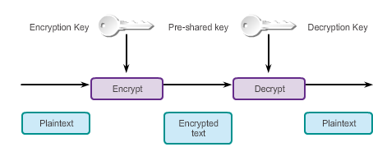
IPsec Framework Symmetric Encryption
Encryption and decryption use the same key.
Each of the two networking devices must know the key to decode the information.
Each device encrypts the information before sending it over the network to the other device.
Typically used to encrypt the content of the message.
Examples: DES and 3DES (no longer considered secure) and AES (256-bit recommended for IPsec encryption).
Notes:
7.3.2.2 Encryption Algorithms

Slide 18
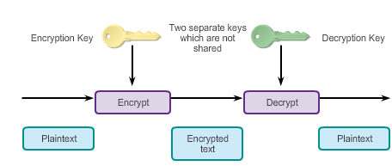
IPsec Framework Asymmetric Encryption
Uses different keys for encryption and decryption.
Knowing one of the keys does not allow a hacker to deduce the second key and decode the information.
One key encrypts the message, while a second key decrypts the message.
Public key encryption is a variant of asymmetric encryption that uses a combination of a private key and a public key.
Typically used in digital certification and key management
Example: RSA
Notes:
7.3.2.2 Encryption Algorithms

Slide 19
IPsec Framework Diffie-Hellman Key Exchange
Diffie-Hellman (DH) is not an encryption mechanism and is not typically used to encrypt data.
DH is a method to securely exchange the keys that encrypt data.
DH algorithms allow two parties to establish a shared secret key used by encryption and hash algorithms.
DH is part of the IPsec standard.
Encryption algorithms, such as DES, 3DES, and AES, as well as the MD5 and SHA-1 hashing algorithms, require a symmetric, shared secret key to perform encryption and decryption.
DH algorithm specifies a public key exchange method that provides a way for two peers to establish a shared secret key that only they know, although they are communicating over an insecure channel.
Notes:
7.3.2.3 Diffie-Hellman Key Exchange

Slide 20
IPsec Framework Integrity with Hash Algorithms
The original sender generates a hash of the message and sends it with the message itself.
The recipient parses the message and the hash, produces another hash from the received message, and compares the two hashes.
If they are the same, the recipient can be reasonably sure of the integrity of the original message.
Notes:
7.3.2.4 Integrity with Hash Algorithms
e.g. HMAC – hash based message authentication code

Slide 21
IPsec Framework Integrity with Hash Algorithms (cont.)
There are two common HMAC algorithms:
MD5 – Uses a 128-bit shared secret key. The variable-length message and 128-bit shared secret key are combined and run through the HMAC-MD5 hash algorithm. The output is a 128-bit hash. The hash is appended to the original message and forwarded to the remote end.
SHA – SHA-1 uses a 160-bit secret key. The variable-length message and the 160-bit shared secret key are combined and run through the HMAC-SHA1 hash algorithm. The output is a 160-bit hash. The hash is appended to the original message and forwarded to the remote end.
Notes:
7.3.2.4 Integrity with Hash Algorithms

Slide 22
IPsec Framework IPsec Authentication (cont.)
There are two peer authentication methods, PSK and RSA signatures:
PSK
A secret key shared between the two parties using a secure channel before it needs to be used.
Use symmetric key cryptographic algorithms.
A PSK is entered into each peer manually and is used to authenticate the peer.
Notes:
7.3.2.5 IPsec Authentication

Slide 23
IPsec Framework IPsec Authentication (cont.)
RSA signatures
Digital certificates are exchanged to authenticate peers.
Local device derives a hash and encrypts it with its private key.
Encrypted hash, or digital signature, is attached to the message and forwarded to the remote end.
At the remote end, the encrypted hash is decrypted using the public key of the local end.
If the decrypted hash matches the recomputed hash, the signature is genuine.
Notes:
7.3.2.5 IPsec Authentication

Slide 24
IPsec Framework IPsec Protocol Framework
Authentication Header (AH)
Appropriate protocol to use when confidentiality is not required or permitted.
Provides data authentication and integrity for IP packets that are passed between two systems.
Does not provide data confidentiality (encryption) of packets.
Encapsulating Security Payload (ESP)
A security protocol that provides confidentiality and authentication by encrypting the IP packet.
Authenticates the inner IP packet and ESP header.
Both encryption and authentication are optional in ESP, at a minimum, one of them must be selected.
Notes:
7.3.2.6 IPsec Protocol Framework

Slide 25
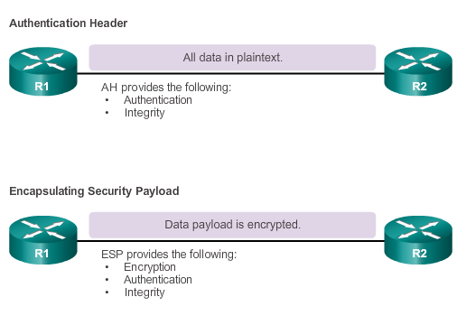
IPsec Framework IPsec Protocol Framework (cont.)
Notes:
7.3.2.6 IPsec Protocol Framework

Slide 26
IPsec Framework IPsec Protocol Framework (cont.)
Four basic building block of the IPsec framework that must be selected:
IPsec framework protocol – A combination of ESP and AH, ESP or ESP+AH options are almost always selected because AH itself does not provide encryption.
Confidentiality (if IPsec is implemented with ESP) – DES, 3DES, or AES, AES is strongly recommended since provides the greatest security.
Integrity – Guarantees that the content has not been altered in transit using hash algorithms (MD5 or SHA).
Authentication – Represents how devices on either end of the VPN tunnel are authenticated (PSK or RSA).
DH algorithm group – Represents how a shared secret key is established between peers, DH24 provides the greatest security.
Notes:
7.3.2.6 IPsec Protocol Framework

Slide 27
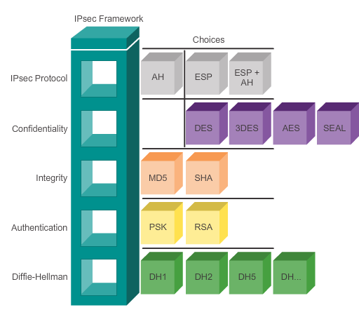
IPsec Framework IPsec Protocol Framework (cont.)
Notes:
7.3.2.6 IPsec Protocol Framework

Slide 28
IPsec Encapsulation Example
192.168.1.0 /24
10.10.10.0 /24
.1
IPsec VPN
.1
Fa0/0
Branch
S0/0/1
S0/0/1
HQ
Fa0/0
.10
.242
.226
.10
209.165.200.240 /29
Internet
209.165.200.224 /29
.241
.225
ISP
Original IP Header Source IP: 192.168.1.10 Destination: 10.10.10.10 | TCP | Data
Original IP Header Source IP: 192.168.1.10 Destination: 10.10.10.10 | TCP | Data
New IP Header Source: 209.165.200.242 Destination: 209.165.200.226 | ESP Header | Original IP Header Source IP: 192.168.1.10 Destination: 10.10.10.10 | TCP | Data | ESP Trailer | ESP Authentication
The example displays how a packet is encapsulated.

Slide 29

Steps to Configuring an IPsec VPN
192.168.1.0 /24
10.10.10.0 /24
.1
IPsec VPN
.1
Fa0/0
Branch
S0/0/1
S0/0/1
HQ
Fa0/0
.242
.226
209.165.200.240 /29
Internet
209.165.200.224 /29
NAT Pool
209.165.200.249 –
209.165.200.253/29
.241
.225
Email Server
10.10.10.238
(209.165.200.238)
Branch Server
192.168.1.254
(209.165.200.254)
NAT Pool
209.165.200.233 –
209.165.200.237 /29
ISP
Configure the initial key (ISAKMP policy) details.
Configure the IPsec details.
Configure the crypto ACL.
Configure the VPN tunnel information.
Apply the crypto map.

Slide 30
IPsec VPN Components
ISAKMP Policy
Contains authentication, encryption and the hashing method commands that are first used to negotiate and exchange credentials with a VPN peer.
IPsec Details
Identifies an acceptable combination of security protocols, algorithms, and other settings.
Crypto ACL
Is an extended IP ACL that identifies the traffic to be protected.
A permit statement results in the traffic being encrypted, while a deny statement sends traffic out in clear text.
Both VPN peers must have reciprocating ACLs.

Slide 31
IPsec VPN Components
VPN Tunnel Information
Binds all tunnel information together.
Identifies the IPsec transform set to use, the peer router, the ACL, and other tunnel information.
Apply the Crypto Map
The named crypto map must be applied to the Internet-facing interface to which the peering router will connect to.

Slide 32
Branch Router IPsec VPN Configuration
Branch# conf t
Branch(config)# crypto isakmp policy 1
Branch(config-isakmp)# encryption aes
Branch(config-isakmp)# authentication pre-share
Branch(config-isakmp)# group 2
Branch(config-isakmp)# exit
Branch(config)# crypto isakmp key cisco123 address 209.165.200.226
Branch(config)#
Branch(config)# crypto ipsec transform-set HQ-VPN esp-sha-hmac esp-3des
Branch(cfg-crypto-trans)# exit
Branch(config)#
Branch(config)# access-list 110 permit ip 192.168.1.0 0.0.0.255 10.10.10.0 0.0.0.255
Branch(config)#
Branch(config)#
Branch(config)# crypto map HQ-MAP 10 ipsec-isakmp
% NOTE: This new crypto map will remain disabled until a peer
Branch(config-crypto-map)# set transform-set HQ-VPN
Branch(config-crypto-map)# set peer 209.165.200.226
Branch(config-crypto-map)# match address 110
Branch(config-crypto-map)# exit
Branch(config)# int s0/0/1
Branch(config-if)# crypto map HQ-MAP
Branch(config-if)# ^Z
Branch#
❶
ISAKMP Policy
Specifies the initial VPN security details
❷
IPsec Details
Specifies how the IPsec packet will be encapsulated
❸
Crypto ACL
Specifies the traffic that will trigger the VPN to activate
❹
VPN Tunnel Information
Creates the crypto map that combines the ISAKMP policy, IPsec transform set, VPN peer address, and crypto ACL
❺
Apply the Crypto Map
Identifies which interface is actively looking to create a VPN
Notes:
Here is a high-level overview of the configuration:
The ISAKMP policy identifies the specifics for the initial key and secure parameters exchange.
The IPsec details define how the IP packet will be encapsulated and how it will be identified by the named HQ VPN.
The VPN tunnel information is identified in the crypto map named HQ-MAP, which combines the ISAKMP policies, IPsec packet detail, the peer address, and ACL 110.
ACL 110 is the crypto access control list that identifies interesting traffic that will trigger the VPN to activate.
Finally, the crypto map is applied to the tunnel interface.

Slide 33
Verifying and Troubleshooting IPsec
Command | Description
show crypto map | Displays display the specifics contained in a crypto map configuration.
show crypto session | Displays the status information of the active crypto sessions.
show crypto ipsec sa | Displays the settings used by current SAs.
debug crypto ipsec | View real time IPsec events.

Slide 34
IPsec VPN Verification Example
192.168.1.0 /24
10.10.10.0 /24
.1
IPsec VPN
.1
Fa0/0
Branch
S0/0/1
S0/0/1
HQ
Fa0/0
.242
.226
209.165.200.240 /29
Internet
209.165.200.224 /29
NAT Pool
209.165.200.249 –
209.165.200.253/29
.241
.225
Email Server
10.10.10.238
(209.165.200.238)
Branch Server
192.168.1.254
(209.165.200.254)
NAT Pool
209.165.200.233 –
209.165.200.237 /29
ISP
Branch# debug crypto ipsec
Crypto IPSEC debugging is on
Branch# ping 10.10.10.1 source 192.168.1.1
Type escape sequence to abort.
Sending 5, 100-byte ICMP Echos to 10.10.10.1, timeout is 2 seconds:
Packet sent with a source address of 192.168.1.1
!!!!!
Success rate is 100 percent (5/5), round-trip min/avg/max = 56/56/60 ms
Branch#
Enable IPsec debugging and generate interesting VPN traffic.
Notice that the ping traffic matches the crypto ACL 110 however, no debug output is generated.
access-list 110 permit ip 192.168.1.0 0.0.0.255 10.10.10.0 0.0.0.255

Slide 35
IPsec VPN Verification Example
192.168.1.0 /24
10.10.10.0 /24
.1
IPsec VPN
.1
Fa0/0
Branch
S0/0/1
S0/0/1
HQ
Fa0/0
.242
.226
209.165.200.240 /29
Internet
209.165.200.224 /29
NAT Pool
209.165.200.249 –
209.165.200.253/29
.241
.225
Email Server
10.10.10.238
(209.165.200.238)
Branch Server
192.168.1.254
(209.165.200.254)
NAT Pool
209.165.200.233 –
209.165.200.237 /29
ISP
Branch# show crypto session
Crypto session current status
Interface: Serial0/0/1
Session status: DOWN
Peer: 209.165.200.226 port 500
IPSEC FLOW: permit ip 192.168.1.0/255.255.255.0 10.10.10.0/255.255.255.0
Active SAs: 0, origin: crypto map
<output omitted>
Although the ping was successful, it appears that the tunnel is down.
NAT has also been implemented.
Perhaps this is causing some problems with the IPsec tunnel being created.

Slide 36
IPsec VPN Verification Example
192.168.1.0 /24
10.10.10.0 /24
.1
IPsec VPN
.1
Fa0/0
Branch
S0/0/1
S0/0/1
HQ
Fa0/0
.242
.226
209.165.200.240 /29
Internet
209.165.200.224 /29
NAT Pool
209.165.200.249 –
209.165.200.253/29
.241
.225
Email Server
10.10.10.238
(209.165.200.238)
Branch Server
192.168.1.254
(209.165.200.254)
NAT Pool
209.165.200.233 –
209.165.200.237 /29
ISP
Branch# debug ip nat
IP NAT debugging is on
Branch# ping 10.10.10.1 source 192.168.1.1
Type escape sequence to abort.
Sending 5, 100-byte ICMP Echos to 10.10.10.1, timeout is 2 seconds:
Packet sent with a source address of 192.168.1.1
!!!!!
Success rate is 100 percent (5/5), round-trip min/avg/max = 56/57/60 ms
Branch#
Enable NAT debugging and ping again.
The pings are again successful.

Slide 37
IPsec VPN Verification Example
192.168.1.0 /24
10.10.10.0 /24
.1
IPsec VPN
.1
Fa0/0
Branch
S0/0/1
S0/0/1
HQ
Fa0/0
.242
.226
209.165.200.240 /29
Internet
209.165.200.224 /29
NAT Pool
209.165.200.249 –
209.165.200.253/29
.241
.225
Email Server
10.10.10.238
(209.165.200.238)
Branch Server
192.168.1.254
(209.165.200.254)
NAT Pool
209.165.200.233 –
209.165.200.237 /29
ISP
Branch#
*Mar 26 16:35:21.251: NAT: s=192.168.1.1->209.165.200.249, d=10.10.10.1 [35]
*Mar 26 16:35:21.307: NAT*: s=209.165.200.238, d=209.165.200.249->192.168.1.1 [35]
*Mar 26 16:35:21.307: NAT: s=192.168.1.1->209.165.200.249, d=10.10.10.1 [36]
*Mar 26 16:35:21.367: NAT*: s=209.165.200.238, d=209.165.200.249->192.168.1.1 [36]
*Mar 26 16:35:21.367: NAT: s=192.168.1.1->209.165.200.249, d=10.10.10.1 [37]
*Mar 26 16:35:21.423: NAT*: s=209.165.200.238, d=209.165.200.249->192.168.1.1 [37]
*Mar 26 16:35:21.423: NAT: s=192.168.1.1->209.165.200.249, d=10.10.10.1 [38]
*Mar 26 16:35:21.479: NAT*: s=209.165.200.238, d=209.165.200.249->192.168.1.1 [38]
*Mar 26 16:35:21.483: NAT: s=192.168.1.1->209.165.200.249, d=10.10.10.1 [39]
*Mar 26 16:35:21.539: NAT*: s=209.165.200.238, d=209.165.200.249->192.168.1.1 [39]
Branch#
The NAT debug output indicates that the internal IP address 192.168.1.1 is being translated to 209.165.200.249.

Slide 38
IPsec VPN Verification Example
192.168.1.0 /24
10.10.10.0 /24
.1
IPsec VPN
.1
Fa0/0
Branch
S0/0/1
S0/0/1
HQ
Fa0/0
.242
.226
209.165.200.240 /29
Internet
209.165.200.224 /29
NAT Pool
209.165.200.249 –
209.165.200.253/29
.241
.225
Email Server
10.10.10.238
(209.165.200.238)
Branch Server
192.168.1.254
(209.165.200.254)
NAT Pool
209.165.200.233 –
209.165.200.237 /29
ISP
Branch# show access-lists
Extended IP access list 110
10 permit ip 192.168.1.0 0.0.0.255 10.10.10.0 0.0.0.255
Extended IP access list BRANCH-NAT-ACL
10 permit ip 192.168.1.0 0.0.0.255 any (1 match)
Branch#
BRANCH-NAT-ACL identifies traffic to translate and has one match.
ACL 110 is for the IPsec VPN.
What is the solution to this problem?

Slide 39
IPsec VPN Verification Example
192.168.1.0 /24
10.10.10.0 /24
.1
IPsec VPN
.1
Fa0/0
Branch
S0/0/1
S0/0/1
HQ
Fa0/0
.242
.226
209.165.200.240 /29
Internet
209.165.200.224 /29
NAT Pool
209.165.200.249 –
209.165.200.253/29
.241
.225
Email Server
10.10.10.238
(209.165.200.238)
Branch Server
192.168.1.254
(209.165.200.254)
NAT Pool
209.165.200.233 –
209.165.200.237 /29
ISP
Branch(config)# no ip access-list extended BRANCH-NAT-ACL
Branch(config)# ip access-list extended BRANCH-NAT-ACL
Branch(config-ext-nacl)# deny ip 192.168.1.0 0.0.0.255 10.10.10.0 0.0.0.255
Branch(config-ext-nacl)# permit ip 192.168.1.0 0.0.0.255 any
Branch(config-ext-nacl)# ^Z
Branch
Alter the NAT ACL to exempt VPN traffic.
The ACL should ignore the Branch LAN traffic going to the HQ LAN!

Slide 40
IPsec VPN Verification Example
192.168.1.0 /24
10.10.10.0 /24
.1
IPsec VPN
.1
Fa0/0
Branch
S0/0/1
S0/0/1
HQ
Fa0/0
.242
.226
209.165.200.240 /29
Internet
209.165.200.224 /29
NAT Pool
209.165.200.249 –
209.165.200.253/29
.241
.225
Email Server
10.10.10.238
(209.165.200.238)
Branch Server
192.168.1.254
(209.165.200.254)
NAT Pool
209.165.200.233 –
209.165.200.237 /29
ISP
Branch# clear ip nat translation *
Branch# clear crypto isakmp
Branch# clear crypto sa
Branch# ping 10.10.10.1 source 192.168.1.1
Type escape sequence to abort.
Sending 5, 100-byte ICMP Echos to 10.10.10.1, timeout is 2 seconds:
Packet sent with a source address of 192.168.1.1
!!!!!
Success rate is 100 percent (5/5), round-trip min/avg/max = 56/57/60 ms
Branch#
Clear the NAT translations and IPsec SAs and generate interesting VPN traffic.

Slide 41
IPsec VPN Verification Example
192.168.1.0 /24
10.10.10.0 /24
.1
IPsec VPN
.1
Fa0/0
Branch
S0/0/1
S0/0/1
HQ
Fa0/0
.242
.226
209.165.200.240 /29
Internet
209.165.200.224 /29
NAT Pool
209.165.200.249 –
209.165.200.253/29
.241
.225
Email Server
10.10.10.238
(209.165.200.238)
Branch Server
192.168.1.254
(209.165.200.254)
NAT Pool
209.165.200.233 –
209.165.200.237 /29
ISP
*Mar 26 18:28:45.166: IPSEC(sa_request): ,
(key eng. msg.) OUTBOUND local= 209.165.200.242, remote= 209.165.200.226,
local_proxy= 192.168.1.0/255.255.255.0/0/0 (type=4),
remote_proxy= 10.10.10.0/255.255.255.0/0/0 (type=4),
protocol= ESP, transform= esp-3des esp-sha-hmac (Tunnel),
lifedur= 3600s and 4608000kb,
spi= 0x0(0), conn_id= 0, keysize= 0, flags= 0x0
*Mar 26 18:28:45.730: IPSEC(validate_proposal_request): proposal part #1
<output omitted>
*Mar 26 18:28:45.738: IPSEC(update_current_outbound_sa): updated peer 209.165.200.226 current outbound sa to SPI 1C838B72!!!!
Success rate is 80 percent (4/5), round-trip min/avg/max = 88/89/92 ms
Branch#
Notes:
The output from the debug crypto ipsec command indicates that the VPN link has been activated.”

Slide 42
IPsec VPN Verification Example
192.168.1.0 /24
10.10.10.0 /24
.1
IPsec VPN
.1
Fa0/0
Branch
S0/0/1
S0/0/1
HQ
Fa0/0
.242
.226
209.165.200.240 /29
Internet
209.165.200.224 /29
NAT Pool
209.165.200.249 –
209.165.200.253/29
.241
.225
Email Server
10.10.10.238
(209.165.200.238)
Branch Server
192.168.1.254
(209.165.200.254)
NAT Pool
209.165.200.233 –
209.165.200.237 /29
ISP
Branch# show crypto session
Crypto session current status
Interface: Serial0/0/1
Session status: UP-ACTIVE
Peer: 209.165.200.226 port 500
IKE SA: local 209.165.200.242/500 remote 209.165.200.226/500 Active
IPSEC FLOW: permit ip 192.168.1.0/255.255.255.0 10.10.10.0/255.255.255.0
Active SAs: 2, origin: crypto map
Branch#
Notes:
The output from the show crypto session command indicates that the VPN link is now up and active.

Slide 43
IPsec VPN Verification Example
192.168.1.0 /24
10.10.10.0 /24
.1
IPsec VPN
.1
Fa0/0
Branch
S0/0/1
S0/0/1
HQ
Fa0/0
.242
.226
209.165.200.240 /29
Internet
209.165.200.224 /29
NAT Pool
209.165.200.249 –
209.165.200.253/29
.241
.225
Email Server
10.10.10.238
(209.165.200.238)
Branch Server
192.168.1.254
(209.165.200.254)
NAT Pool
209.165.200.233 –
209.165.200.237 /29
ISP
Branch# show crypto ipsec sa
interface: Serial0/0/1
Crypto map tag: HQ-MAP, local addr 209.165.200.242
protected vrf: (none)
local ident (addr/mask/prot/port): (192.168.1.0/255.255.255.0/0/0)
remote ident (addr/mask/prot/port): (10.10.10.0/255.255.255.0/0/0)
current_peer 209.165.200.226 port 500
PERMIT, flags={origin_is_acl,}
#pkts encaps: 4, #pkts encrypt: 4, #pkts digest: 4
#pkts decaps: 4, #pkts decrypt: 4, #pkts verify: 4
#pkts compressed: 0, #pkts decompressed: 0
#pkts not compressed: 0, #pkts compr. failed: 0
<output omitted>
Notes:
The output from the show crypto ipsec sa command indicates that four packets have been encrypted and decrypted.

Slide 44
IPsec VPN Verification Example
192.168.1.0 /24
10.10.10.0 /24
.1
IPsec VPN
.1
Fa0/0
Branch
S0/0/1
S0/0/1
HQ
Fa0/0
.242
.226
209.165.200.240 /29
Internet
209.165.200.224 /29
NAT Pool
209.165.200.249 –
209.165.200.253/29
.241
.225
Email Server
10.10.10.238
(209.165.200.238)
Branch Server
192.168.1.254
(209.165.200.254)
NAT Pool
209.165.200.233 –
209.165.200.237 /29
ISP
The example confirmed that the Branch router and HQ router have an established VPN.
Notice how a service such as NAT could impact the creation of the VPN tunnel.

Slide 45
IPsec VPN Verification Example
192.168.1.0 /24
10.10.10.0 /24
.1
IPsec VPN
.1
Fa0/0
Branch
S0/0/1
S0/0/1
HQ
Fa0/0
.242
.226
209.165.200.240 /29
Internet
209.165.200.224 /29
NAT Pool
209.165.200.249 –
209.165.200.253/29
.241
.225
Email Server
10.10.10.238
(209.165.200.238)
Branch Server
192.168.1.254
(209.165.200.254)
NAT Pool
209.165.200.233 –
209.165.200.237 /29
ISP
Currently the VPN link is only enabled due to static routing.
What would happen if EIGRP was configured to operate over the link?
Would it work?

Slide 46
IPsec VPN Verification Example
192.168.1.0 /24
10.10.10.0 /24
.1
IPsec VPN
.1
Fa0/0
Branch
S0/0/1
S0/0/1
HQ
Fa0/0
.242
.226
209.165.200.240 /29
Internet
209.165.200.224 /29
NAT Pool
209.165.200.249 –
209.165.200.253/29
.241
.225
Email Server
10.10.10.238
(209.165.200.238)
Branch Server
192.168.1.254
(209.165.200.254)
NAT Pool
209.165.200.233 –
209.165.200.237 /29
ISP
A significant drawback of an IPsec VPN is that it cannot route multicast and broadcast packets and therefore cannot support IGPs.
However, IPsec can be combined with generic routing encapsulation (GRE) to create a tunnel to circumvent the issue.

Slide 47
Sending IGP Traffic Over IPsec
IPsec does not support multicast, therefore does not support routing protocols.
Routing protocols are encapsulated with a GRE header.
The packet encapsulated by GRE is then encapsulated with IPsec.
Therefore, IPsec encrypts the GRE packet which contains the routing update.
IPsec
Crypto
Map
Routing Protocol Updates
GRE Tunnel
IPsec Encrypted Traffic

Slide 48
Transport, Carrier, Passenger Protocols
In our scenario, the payload of GRE packets will be EIGRP routing updates and LAN-to-LAN corporate traffic.
The GRE packet will then be encapsulated inside an IPsec packet.
Therefore, IPsec is the “transport protocol,” and GRE is the “carrier protocol” used to carry other “passenger protocols,” such as IP broadcast or IP multicast, and non-IP protocols
Transport
Protocol
Carrier
Protocol
Passenger
Protocol
IPsec (New IP Header) | GRE | Network Packet (Original IP header and Data)

Slide 49
GRE Encapsulation
Passenger Protocol
Original IP Header
TCP
Data
GRE Encapsulation
Carrier Protocol
GRE
IP Header
GRE
GRE
Original IP Header
TCP
Data
IPsec Encapsulation
(Tunnel Mode)
Transport Protocol
GRE
New IP / UDP Header
ESP Header
GRE
IP Header
GRE
Original IP Header
ESP Trailer
ESP Authentication
TCP
Data
Notes:
GRE adds an additional 24 bytes to the original packet.

Slide 50
Steps to Configuring GRE
192.168.1.0 /24
GRE Tunnel
172.16.100.0/30
10.10.10.0 /24
172.16.100.2
172.16.100.0.1
.1
.1
Fa0/0
Branch
S0/0/1
S0/0/1
HQ
Fa0/0
.242
.226
209.165.200.240 /29
Internet
209.165.200.224 /29
NAT Pool
209.165.200.249 –
209.165.200.253/29
.241
.225
Email Server
10.10.10.238
(209.165.200.238)
Branch Server
192.168.1.254
(209.165.200.254)
NAT Pool
209.165.200.233 –
209.165.200.237 /29
ISP
Create a tunnel interface for GRE.
Configure GRE tunnel parameters including IP address, source and destination tunnel addresses, and tunnel mode.
Change the crypto ACL to encrypt GRE traffic.
Configure routing protocols to route through the GRE tunnel.

Slide 51
Configuring GRE Example
192.168.1.0 /24
GRE Tunnel
172.16.100.0/30
10.10.10.0 /24
172.16.100.2
172.16.100.1
.1
.1
Fa0/0
Branch
S0/0/1
S0/0/1
HQ
Fa0/0
.242
.226
209.165.200.240 /29
Internet
209.165.200.224 /29
NAT Pool
209.165.200.249 –
209.165.200.253/29
.241
.225
Email Server
10.10.10.238
(209.165.200.238)
Branch Server
192.168.1.254
(209.165.200.254)
NAT Pool
209.165.200.233 –
209.165.200.237 /29
ISP
Branch(config)# no access-list 110
Branch(config)# access-list 110 permit gre host 209.165.200.242 host 209.165.200.226
Branch(config)# router eigrp 1
Branch(config-router)# network 192.168.1.0 0.0.0.255
Branch(config-router)# network 172.16.100.0 0.0.0.3
Branch(config-router)# no auto-summary
Branch(config-router)#
Change the ACL and add the Internet link and GRE tunnel network to EIGRP on the Branch router.

